Slide 1
Audionova

Slide 2
Presentazione AudioNova & Gruppo Sonova
Ipoacusia e Benessere
I nostri prodotti

Slide 3

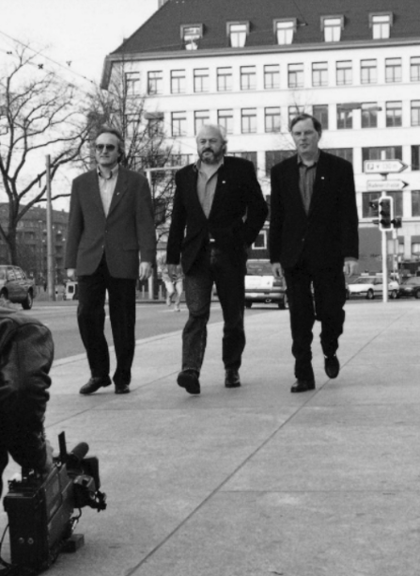






1947
Il nostro percorso inizia nel 1947 con la fondazione di
«AG fur Elektroakustik» a Zurigo, in Svizzera e racconta la storia
di un piccolo business familiare che è cresciuto fino a diventare
l’azienda globale che è Sonova oggi.
1965
Quando Andy Rihs prese il controllo della compagnia con il fratello HansUeli Rihs e il loro migliore amico Beda Diethelm nel 1965,
iniziò il vero e proprio percorso di crescita dell’azienda, che,
grazie all’esperienza dei tre proprietari, si indirizzò verso il successo. Ciò che caratterizzava il loro lavoro fu sempre la loro visione e la loro mission aziendale di un mondo dove tutti possono godere della gioia di sentire e vivere una vita senza limitazioni.
Questo concetto, insieme all’attenzione alle persone – legata alla convinzione che un’azienda non è nulla senza persone che credano
nel proprio lavoro – rimane parte della cultura di Sonova oggi
e rende la nostra compagnia quello che è tutt’ora.

Slide 4
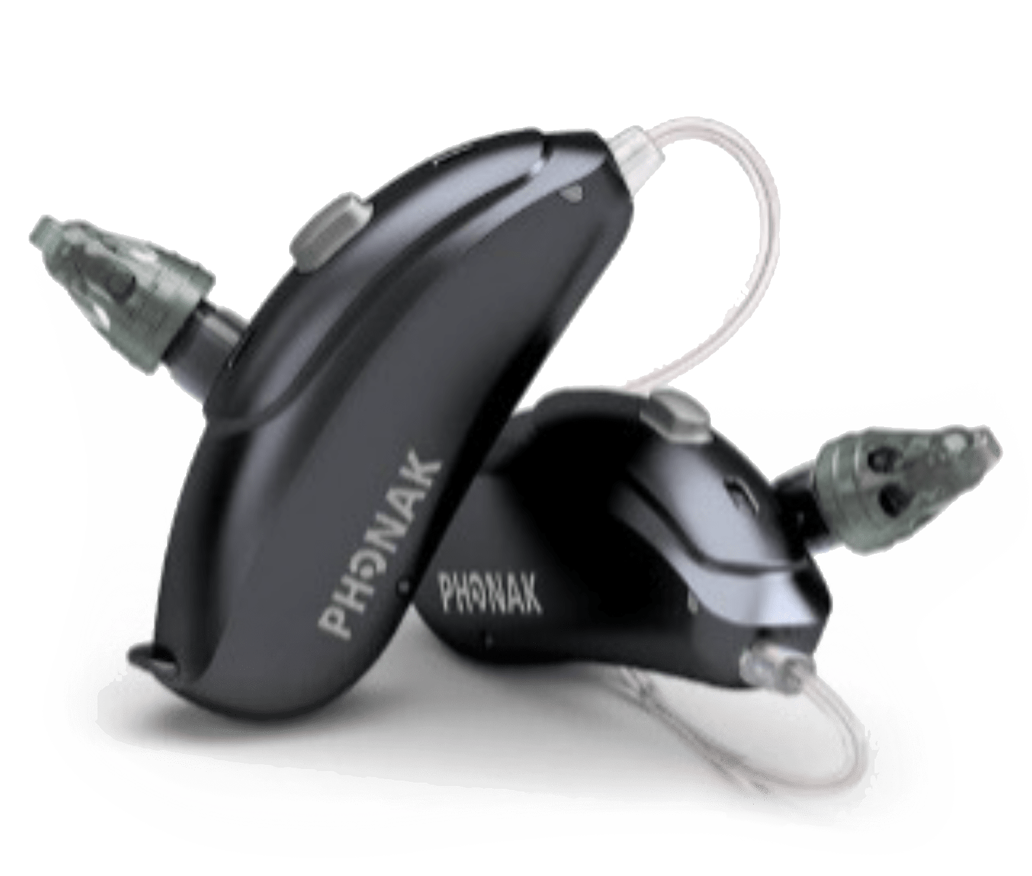
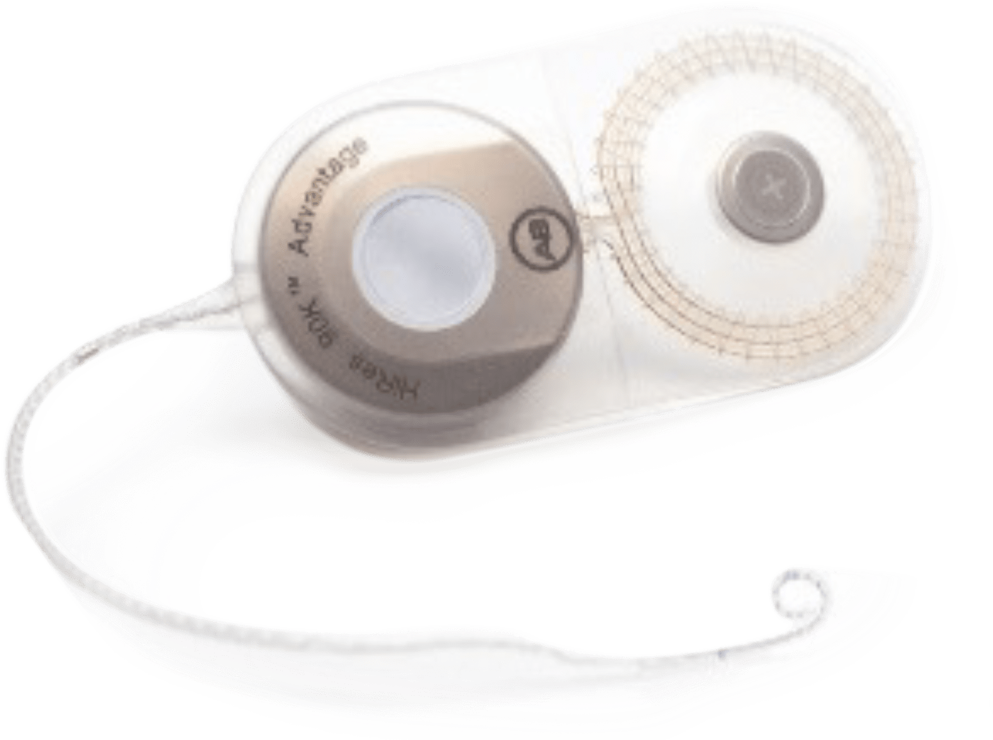
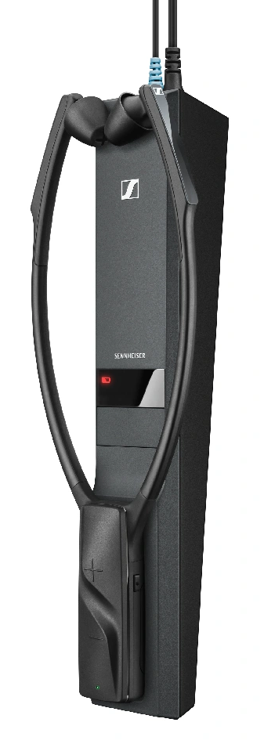


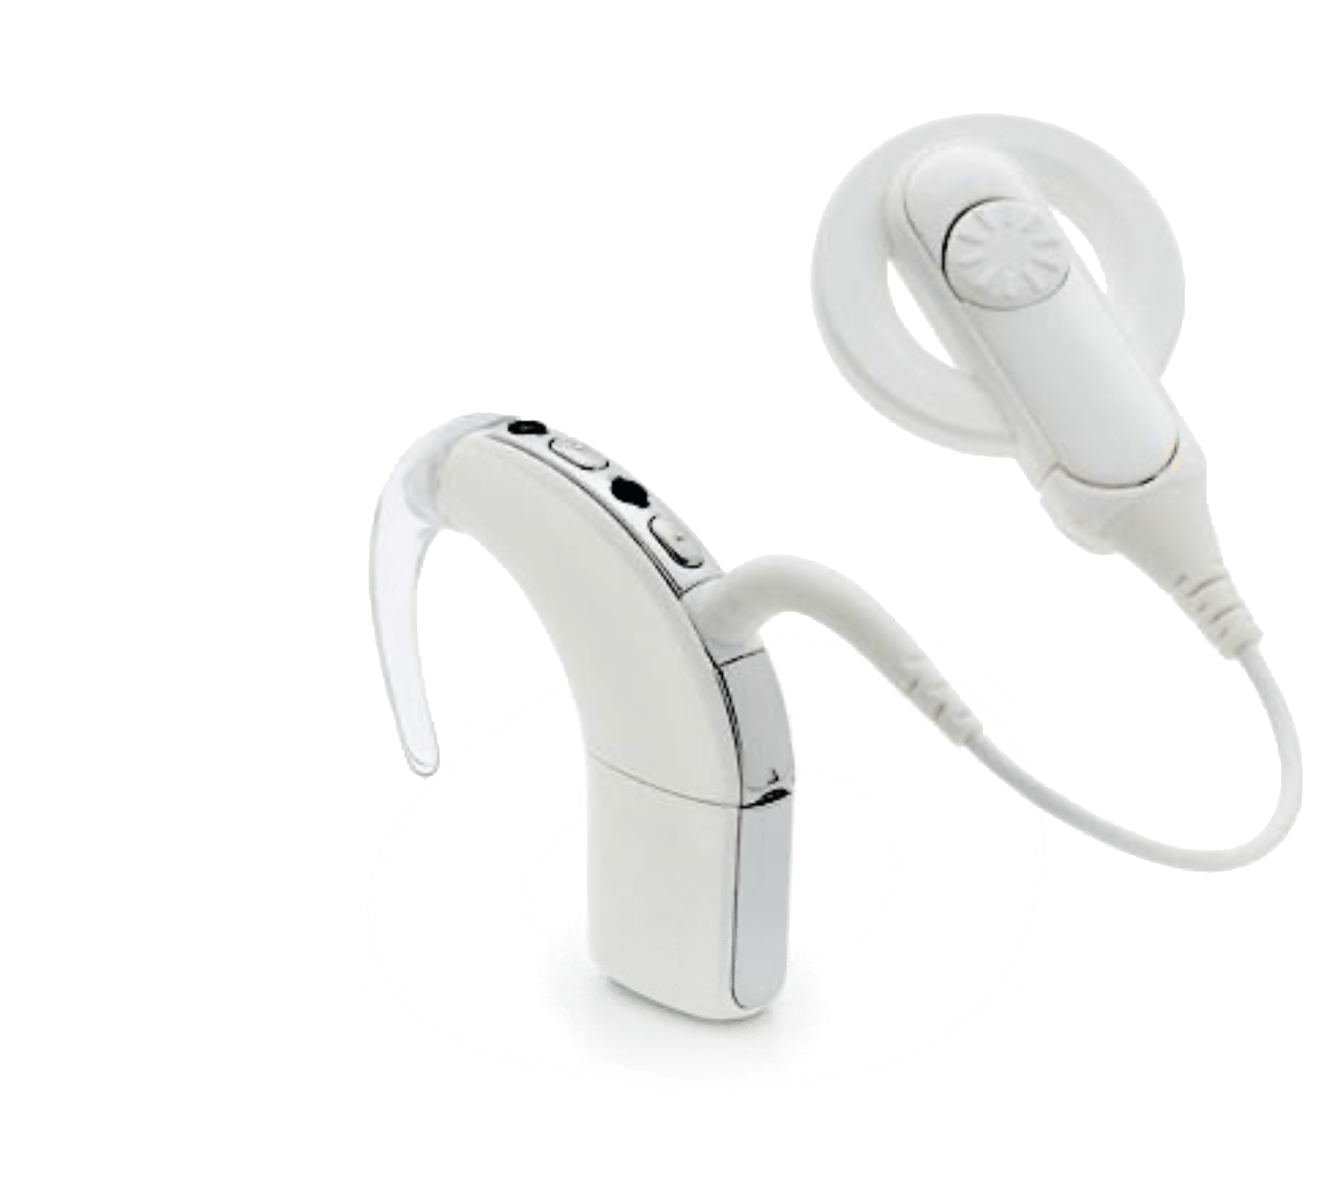
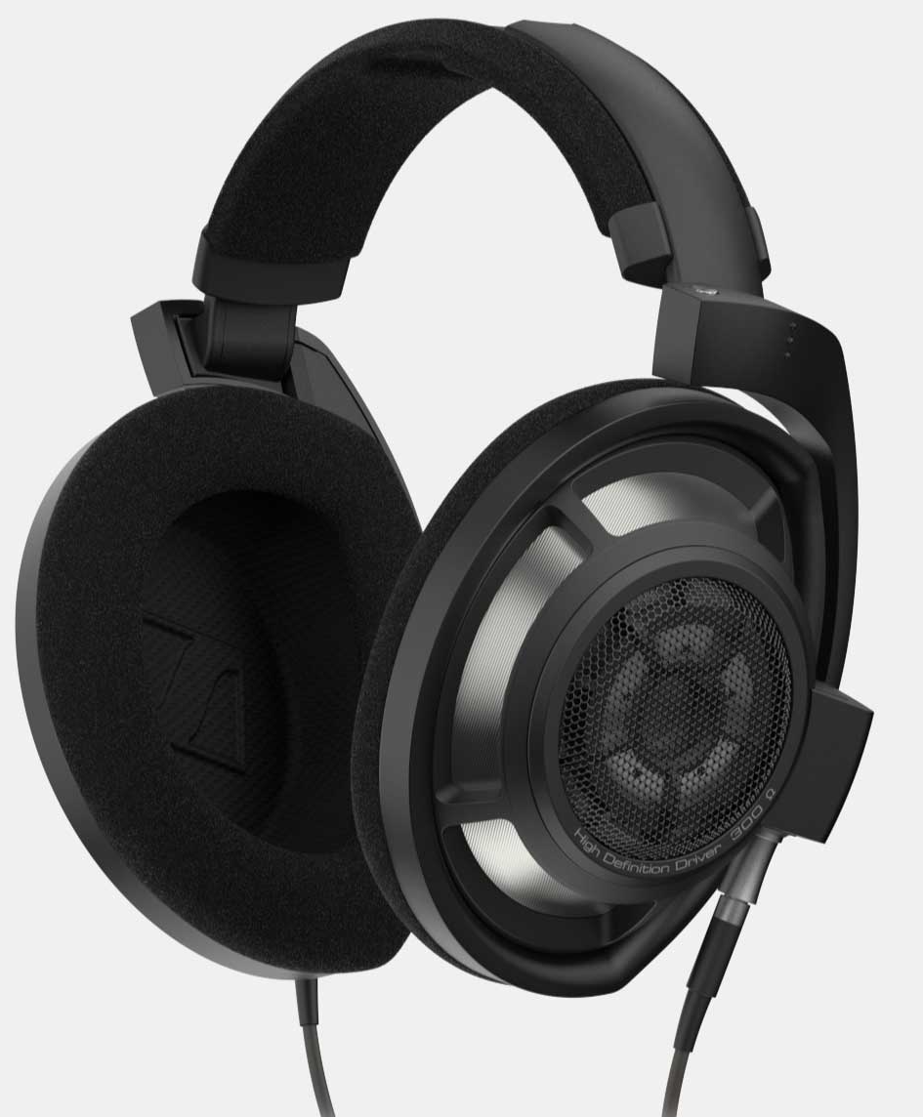
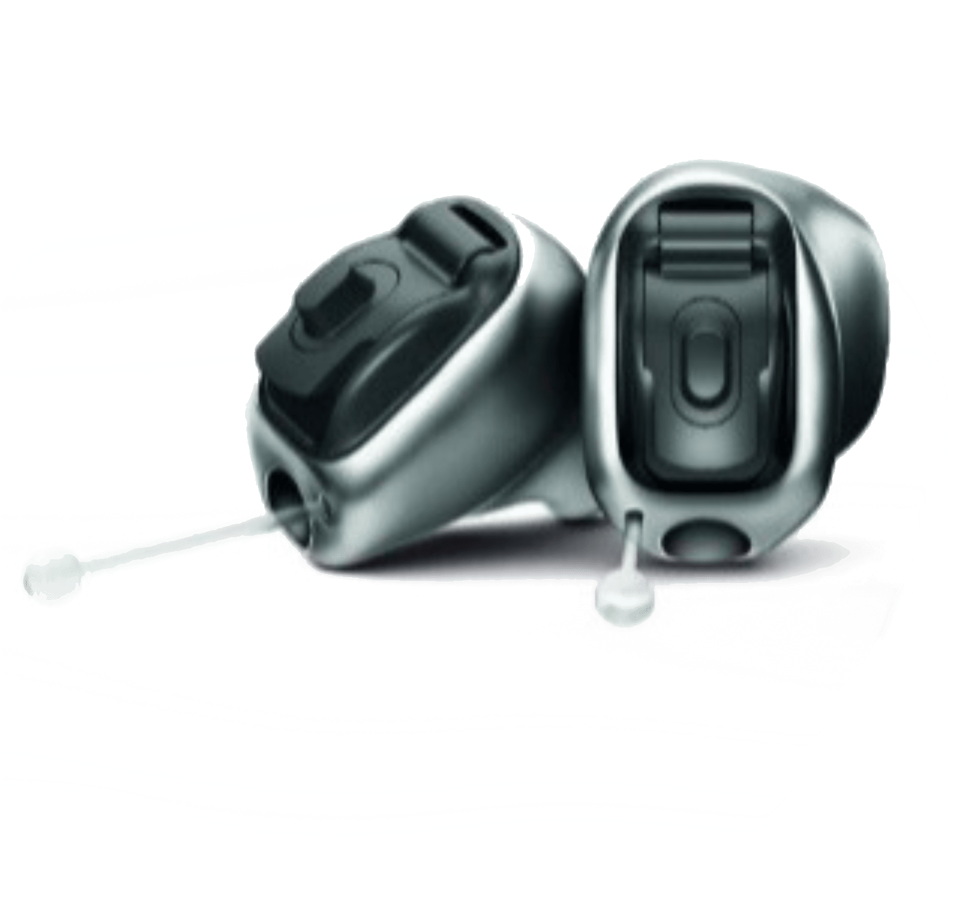
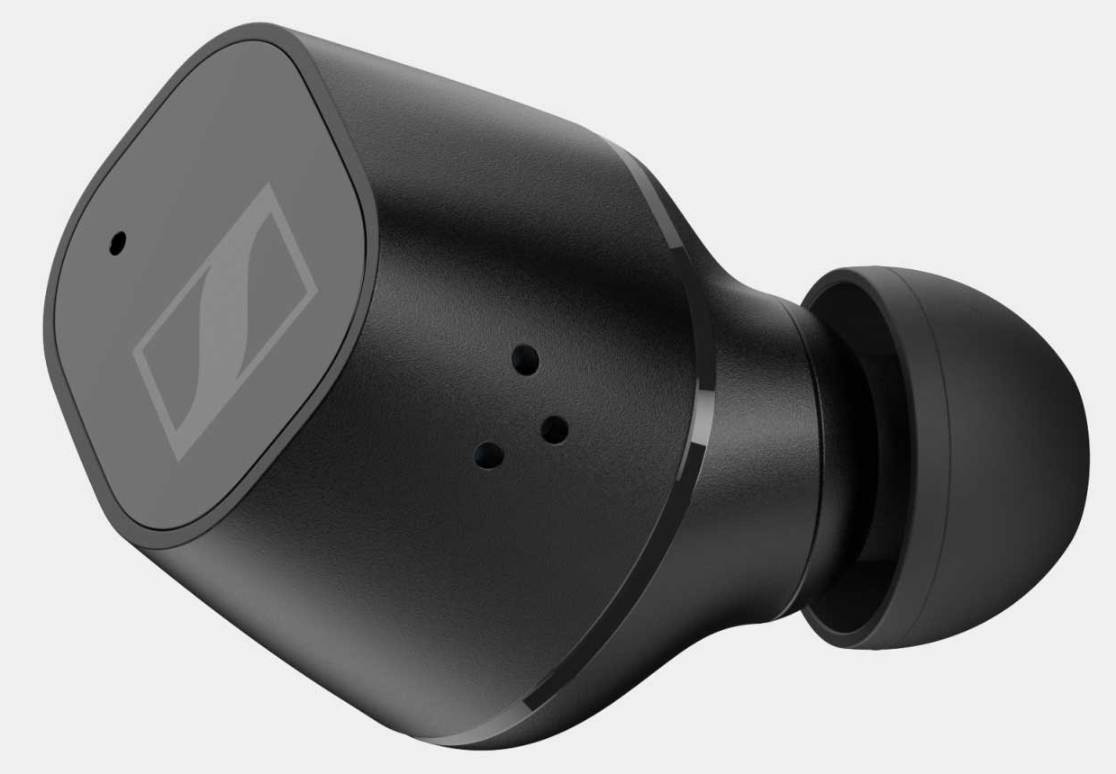







I nostri caratteri distintivi
INNOVAZIONE
SERVIZI
PERFORMANCE
EVOLUZIONE
Apparecchi acustici
Retail
Impianti
cocleari
Sistemi avanzati per l’ascolto

Slide 5












Una piattaforma
globale Retail di
4.000
AMERICAS
Centri Acustici
128
288
ASIA
Uno dei network leader
in Europa con più di
2.500
190
124
52
13
Centri Acustici
in 13 paesi
6
Oltre 6.000
dipendenti in più
di 20 paesi nel mondo
EUROPE
490
78
127
217
72
288
174
88
733
240
190

Slide 6







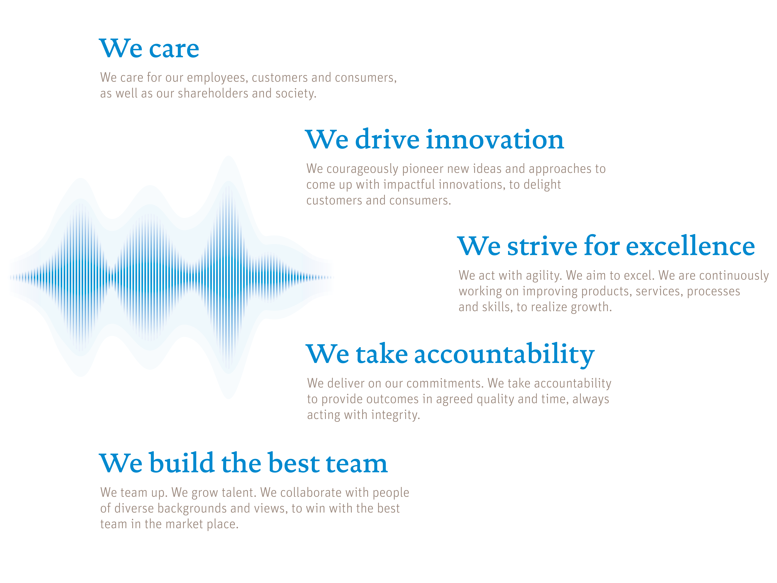
I NOSTRI VALORI
Ci prendiamo CURA del benessere dei nostri pazienti
e dei nostri dipendenti
Creiamo il MIGLIOR TEAM
formando e valorizzando in modo costante
i nostri audioprotesisti
La nostra ricerca per l’INNOVAZIONE
è orientata ai reali vantaggi per i pazienti
Immaginiamo un mondo in cui tutti possano godere
della gioia di sentire,
per vivere una vita senza limiti
La nostra RESPONSABILITÀ
ci impegna a garantire i migliori risultati nella massima integrità
Raggiungere sempre L’ECCELLENZA
è l’obiettivo dei nostri prodotti e servizi

Slide 7

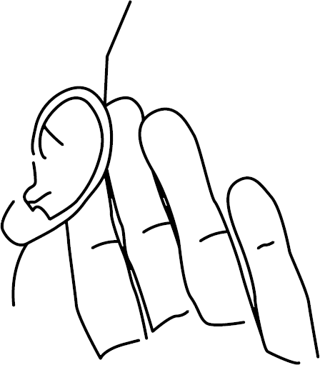
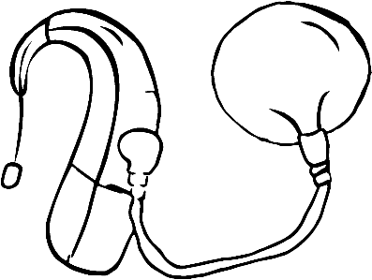
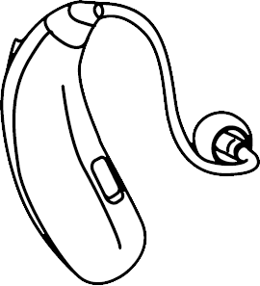


Un unico grande gruppo,
al servizio delle persone
che vogliono ritrovare
il benessere dell’udito
2007
2024
19
Centri
acustici
220
Centri
acustici
La prima catena italiana per numero di
Centri acustici diretti

Slide 8

Sentire bene per vivere bene
Notes:
Welcome to the Well-Hearing is Well-BeingTM Comprehensive Training Package.
Our Phonak mission, to offer a “Life a Life without Limits”, naturally leads us to consider how hearing loss influences overall “well-being”. Hearing well helps to keep us socially, emotionally, and physically connected to the world around us which can be important to our sense of well-being. Therefore, identifying and treating hearing loss is important. As we understand the complexity of well-being, especially in a hearing health care context, we may provide clinicians with new knowledge and skills to support their clients with hearing loss along their rehabilitative journey.
Phonak, in collaboration with key opinion leading researchers, provides a high-level overview of current scientific evidence linking hearing and hearing rehabilitation to well-being n our position paper - -Phonak Well-Hearing is Well-Being^{TM .} which was published in the Hearing Review in 2020 .
“Well-hearing is Well-Being™” is a trademark of Phonak.

Slide 9
Ipoacusia e benessere
9
1/30/2025
| Sentire bene per vivere bene
Notes:
In terms of Well-Hearing is Well-Being, Phonak believes that hearing care providers, or HCPs, are uniquely positioned to raise awareness, and put hearing loss and hearing rehabilitation into this much broader context. Therefore, HCPs can play a key role in changing the conversation from “needing a hearing aid because
you do not hear well”, to a conversation about what hearing and hearing rehabilitation can truly mean for an individual in the context of well-being.

Slide 10




Ipoacusia e benessere
L’ipoacusia può avere un impatto su tutte e 3 le dimensioni del benessere proposte dall'OMS¹
Fisico
Cognitivo
Sociale
C'è preoccupazione riguardo al benessere in quanto¹:
l'impatto dell'ipoacusia sul benessere è spesso sottovalutato
l’ipoacusia è di gran lunga prevalente
l'ipoacusia non è trattata in modo adeguato
Organizzazione Mondiale della Sanità (OMS). (1948). Costituzione dell'Organizzazione Mondiale della Sanità (OMS). Genova, Svizzera: OMS.
10
1/30/2025
| Sentire bene per vivere bene
Notes:
When we look at hearing loss and its impact on Well-being, research shows that hearing loss , and the communication challenges due to hearing loss can impact all 3 well-being dimensions put forward by the WHO¹
Concern is warranted because the impact of hearing loss on well-being is still very often underestimated.
Additionally, hearing loss is highly prevalent, and highly undertreated.
Earlier and higher rates of diagnosis and intervention for hearing loss supports not only better communication outcomes but overall well being
Let’s explore this in more detail…
¹ World Health Organization (WHO). (1948). Constitution of the World Health Organization. Geneva, Switzerland: WHO.

Slide 11

Impatto dell’ipoacusia sottostimato
L'ipoacusia è associata a fattori come:
patologie coesistenti / soggiacenti¹
maggiore rischio di cadute², maggiore utilizzo dei servizi sanitari³
Kramer, S.E., Kapteyn, T.S., Kuik, D.J., & Deeg, D.J.H. (2002). The association of hearing impairment and chronic diseases with psychosocial health status in older age. Journal of Aging and Health, 14(1), 122–137.
Nachtegaal, J., Smit, J.H., Smits, C., Bezemer, P.D., van Beek, J.H.M., Festen, J.M., & Kramer, S.E. (2009). The Association Between Hearing Status and Psychosocial Health Before the Age of 70 Years: Results from an internet-based National Survey on Hearing. Ear and Hearing, 30(3), 302–312.
Keidser, G., & Seeto, M. (2017). The Influence of Social Interaction and Physical Health on the Association Between Hearing and Depression With Age and Gender. Trends in Hearing, 21, 1-15.
Ciorba, A., Bianchini, C., Pelucchi, S., & Pastore, A. (2012). The impact of hearing loss on the quality of life of elderly adults. Clinical Interventions in Aging, 7, 159–163.
maggiori percentuali e accelerazione del declino cognitivo⁴
aumento della solitudine⁵, stress⁶, pensieri depressivi^{6,7} e nel complesso una minore qualità di vita⁸
Loughrey, D.G., Kelly, M.E., Kelley, G.A., Brennan, S., & Lawlor, B. A. (2018). Association of Age-Related Hearing Loss With Cognitive Function, Cognitive Impairment, and Dementia. JAMA Otolaryngology–Head & Neck Surgery, 144(2), 115-126.
Jiam, N.T.-L., Li, C., & Agrawal, Y. (2016). Hearing loss and falls: A systematic review and meta-analysis. The Laryngoscope, 126(11), 2587–2596.
Mick, P., Foley, D., Lin, F., & Pichora-fuller, M.K. (2018). Hearing Difficulty Is Associated With Injuries Requiring Medical Care. Ear and Hearing, 39(4), 631–644.
Besser, J., Stropahl, M., Urry, E., & Launer, S. (2018). Comorbidities of hearing loss and the implications of multimorbidity for audiological care. Hearing Research, 369, 3–14.
| Sentire bene per vivere bene
Notes:
Research shows that hearing loss is more than just a peripheral sensory issue. For example, it is also associated with such factors as:
Coexisting and/or underlying diseases¹
Higher risks of falls² and increased use of health care services^{3,}
Hearing loss can even put an individual at more risk of developing clinically significant cognitive issues at an older age than their normal hearing peers⁴
And sadly, Increased loneliness⁵, distress⁶, depressive thoughts^{6,7} and overall a lower quality of life⁸. can be associated with hearing loss.
Besser, J., Stropahl, M., Urry, E., & Launer, S. (2018). Comorbidities of hearing loss and the implications of multimorbidity for audiological care. Hearing Research, 369, 3–14.
Jiam, N.T.-L., Li, C., & Agrawal, Y. (2016). Hearing loss and falls: A systematic review and meta-analysis. The Laryngoscope, 126(11), 2587–2596.
Mick, P., Foley, D., Lin, F., & Pichora-fuller, M.K. (2018). Hearing Difficulty Is Associated With Injuries Requiring Medical Care. Ear and Hearing, 39(4), 631–644.
Loughrey, D.G., Kelly, M.E., Kelley, G.A., Brennan, S., & Lawlor, B. A. (2018). Association of Age-Related Hearing Loss With Cognitive Function, Cognitive Impairment, and Dementia. JAMA Otolaryngology–Head & Neck Surgery, 144(2), 115-126.
Kramer, S.E., Kapteyn, T.S., Kuik, D.J., & Deeg, D.J.H. (2002). The association of hearing impairment and chronic diseases with psychosocial health status in older age. Journal of Aging and Health, 14(1), 122–137.
Nachtegaal, J., Smit, J.H., Smits, C., Bezemer, P.D., van Beek, J.H.M., Festen, J.M., & Kramer, S.E. (2009). The Association Between Hearing Status and Psychosocial Health Before the Age of 70 Years: Results from an internet-based National Survey on Hearing. Ear and Hearing, 30(3), 302–312.
Keidser, G., & Seeto, M. (2017). The Influence of Social Interaction and Physical Health on the Association Between Hearing and Depression With Age and Gender. Trends in Hearing, 21, 1-15.
Ciorba, A., Bianchini, C., Pelucchi, S., & Pastore, A. (2012). The impact of hearing loss on the quality of life of elderly adults. Clinical Interventions in Aging, 7, 159–163.

Slide 12
Ipoacusia e benessere cognitivo
Rischio di demenza con ipoacusia non trattata¹
5volte
3volte
2volte
Udito normale
Ipoacusia lieve
Ipoacusia moderata
Ipoacusia severa
Lin, F. R., Metter, E. J., O’Brien, R. J., Resnick, S. M., Zonderman, A. B., & Ferrucci, L. (2011). Hearing loss and incident dementia. Archives of neurology, 68(2), 214-220.
12
1/30/2025
| Sentire bene per vivere bene
Notes:
As hearing care professionals, we should be concerned with cognitive well-being.
The Lin study, published in 2011 shows that with untreated hearing loss comes an increased risk of dementia.
In fact, Lin and colleagues found that those with mild loss had 2 times the increased risk compared to their normal hearing peers. As the amount of hearing loss increased, so did the risk of dementia. Those with a severe hearing loss had a risk factor 5 times greater than those with normal hearing.
¹Lin, F. R., Metter, E. J., O’Brien, R. J., Resnick, S. M., Zonderman, A. B., & Ferrucci, L. (2011). Hearing loss and incident dementia. Archives of neurology, 68(2), 214-220.

Slide 13
Ipoacusia e cadute
Le stesse persone che hanno problemi di udito spesso sono esposte anche al rischio di cadere¹
Le probabilità di caduta aumentano quando l'ipoacusia è più severa^{2,3,4,5}
Probabilità/Rischio di caduta
Aumentano da 2 a 3 volte
in un gruppo di persone anziane in caso di ipoacusia²
National Institute on Aging. 2o17 Bethesda MD. Prevent Falls and Fractures consultato il 7-3-2021 https://www.nia.nih.gov/health/prevent-falls-and-fractures.
Lin, F. R., & Ferrucci, L. (2012). Hearing loss and falls among older adults in the United States. Archives of internal medicine, 172(4), 369–371. https://doi.org/10.1001/archinternmed.2011.728.
Campos J., Ramkhalawansingh R., Pichora-Fuller M. K. Hearing, self-motion perception, mobility, and aging. Hear Res, (2018). 369, 42–55.
Agmon M., Lavie L., Doumas M. The association between hearing loss, postural control, and mobility in older adults: a systematic review. J Am Acad Audiol, (2017). 28, 575–588.
Jiam N. T., Li C., Agrawal Y. Hearing loss and falls: a systematic review and meta-analysis. Laryngoscope, (2016). 126, 2587–2596.
| Sentire bene per vivere bene
Notes:
In the case of an aged population, the same people who have hearing problems often also are at risk of falling⁵
Investigations to the occurrence of falls associated with hearing loss found that the odds or risk of falling were 2 to 3 times in an elderly group in case of hearing loss¹ And as the degree of hearing loss increased to severe, so did the odds of falling.^{1,2,3,4}
Lin, F. R., & Ferrucci, L. (2012). Hearing loss and falls among older adults in the United States. Archives of internal medicine, 172(4), 369–371. https://doi.org/10.1001/archinternmed.2011.728
Campos J., Ramkhalawansingh R., Pichora-Fuller M. K. Hearing, self-motion perception, mobility, and aging. Hear Res, (2018). 369, 42–55
Agmon M., Lavie L., Doumas M. The association between hearing loss, postural control, and mobility in older adults: a systematic review. J Am Acad Audiol, (2017). 28, 575–588
Jiam N. T., Li C., Agrawal Y. Hearing loss and falls: a systematic review and meta-analysis. Laryngoscope, (2016). 126, 2587–2596
National Institute on Aging. 2o17 Bethesda MD. Prevent Falls and Fractures retrieved on 3-7-2021 https://www.nia.nih.gov/health/prevent-falls-and-fractures

